Slide 1
Semester Two - Week 4
Data Management and Ethical Considerations in Research

Slide 2
This week’s session focuses on two critical components of research practice:
how to manage data efficiently and how to approach ethical issues with care.
I have based the following introductory notes on the prescribed text by Kumar (2011), specifically Chapter 13: Ethical Issues and Chapter 18: Writing a Research Proposal (ethical compliance), as well as other sources as noted in the text.

Slide 3
Data is best managed by following the Research Data Lifecycle, which outlines the stages through which research data moves from creation to long-term preservation.
This cycle supports effective research data management, involving organising, documenting, publishing, and archiving research outputs, including datasets, software, metadata, and observations.
Students are expected to understand both the practical and ethical responsibilities of handling data throughout the research cycle.

Slide 4
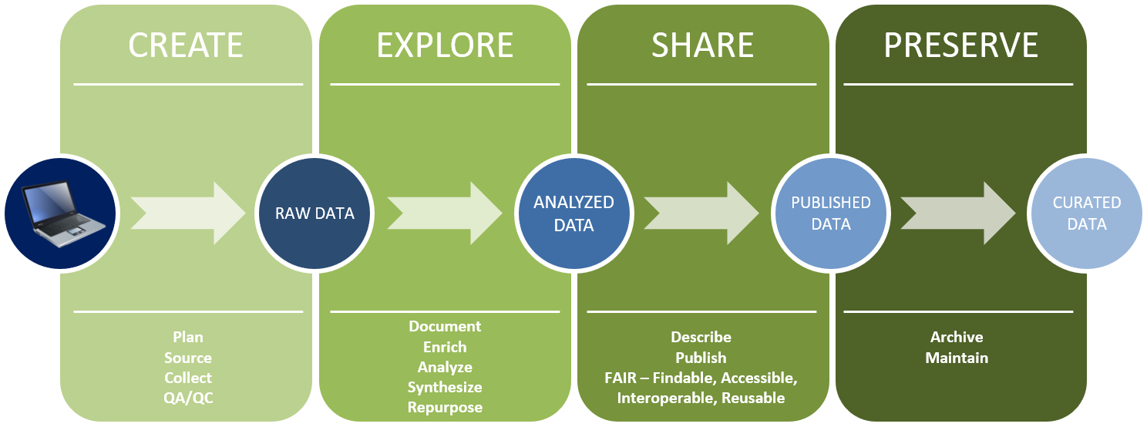
CPUT recommends a Data Management Plan (DMP) outlining how research data will be handled during and after research projects. The purpose of the DMP is to ensure that CPUT complies with all legal, ethical, and contractual obligations and promotes best practices in managing research data.
Figure 1 Research Data Phases

Slide 5
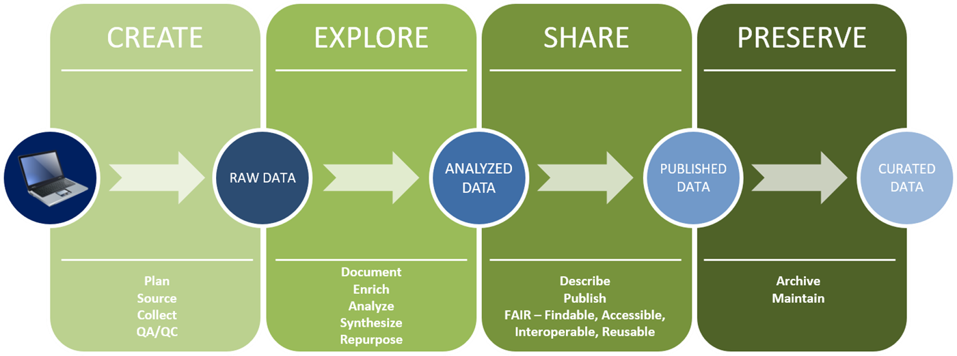
A. CREATE (Raw Data Generation)
Activities involved with the creation of research data include:
Plan: Define research objectives and methods.
Source: Identify tools and data platforms.
Collect: Gather primary data.
QA/QC: Conduct quality assurance and control.
Example:
In ICT, students might collect user interaction logs from an e-learning platform or run an app that tracks system performance.

Slide 6
B. EXPLORE (Data Processing and Analysis)
Activities involved with the exploration of research data include:
Document: Record methods and metadata.
Enrich: Add contextual data.
Analyse: Interpret data using statistical or qualitative tools.
Synthesise: Integrate different data sources.
Repurpose: Consider secondary use of data.
Example:
ICT researchers might analyse mobile app analytics to understand usage patterns or compare feedback with backend logs.

Slide 7
C. SHARE (Dissemination and Access)
Activities involved with the sharing of research data include:
• Describe: Create metadata.
• Publish: Share in repositories or with publications.
• Follow FAIR principles: Ensure data is Findable, Accessible, Interoperable, and Reusable.
Example:
Publishing anonymised survey datasets from a usability study in an open repository, or sharing code on GitHub.

Slide 8
D. PRESERVE (Long-Term Stewardship)
Activities involved with the preservation of research data include:
• Archive: Deposit in institutional/national archives.
• Maintain: Update and use open formats for accessibility.
Example:
Preserving IoT sensor data from a smart classroom for future research or storing interview transcripts with permanent identifiers.

Slide 9
The Research Data Lifecycle illustrates that research data is a critical research output requiring ongoing attention throughout a research project’s lifecycle.
From planning and collection to sharing and archiving, each stage supports transparency, reuse, and the long-term value of research.
It also aligns with global trends promoting open science, data sharing, and robust data stewardship.

Slide 10
E. Principles of Research Ethics
Ethical considerations are fundamental to the integrity of any academic research.
Central to research ethics are two foundational principles: beneficence, the obligation to do good, and non-maleficence, the duty to avoid causing harm.
These principles guide researchers in ensuring that their work respects and protects the rights and well-being of participants.
Vanclay, Baines & Taylor (2013) state that at the heart of ethical research are two core ideas: respect for participants and informed consent.
These serve as the foundation for all other ethical principles and should guide everyone involved in data collection, whether you are an academic researcher or an IT practitioner working in applied IT settings.

Slide 11
E. Principles of Research Ethics
Vanclay, F., Baines, J. T., & Taylor, C. N. (2013). Principles for ethical research involving humans: ethical professional practice in impact assessment Part I. Impact Assessment and Project Appraisal, 31(4), 243–253. https://doi.org/10.1080/14615517.2013.850307
1 2
Respect for Participants
Informed Consent
3 4
Voluntary Participation and Right to Withdraw
Transparency and Avoiding Harm
5 6
Privacy, Anonymity, and Confidentiality
Data Security and Responsible Handling
7 8
Inclusive and Ethical Practice
Methodological Integrity

Slide 12
1. Respect for Participants
This means treating everyone involved in your study with dignity.
You should never judge, discredit, or misrepresent participants.
Their views must be accurately recorded and fairly considered during analysis.
Even the term 'participant' rather than 'subject' or 'respondent' reflects this respect.
Special care should be taken when working with vulnerable or marginalised groups, including people with limited autonomy and Indigenous communities.
Their participation must be handled with extra sensitivity and ethical attention.

Slide 13
2. Informed Consent
People must willingly agree to take part in your research, with full understanding of what is involved.
This means explaining the purpose of the study, what will happen to their data, and any potential risks.
Consent should typically be documented in writing and stored securely in case it needs to be reviewed later (Israel and Hay, 2006 ).
If you are recording audio, video, or taking photos, you must get explicit permission in advance.
This may also be a legal requirement depending on the country.
Israel M, Hay I. 2006. Research ethics for social scientists: between ethical conduct and regulatory compliance. London: Sage.

Slide 14
3. Voluntary Participation and Right to Withdraw
Participation must be voluntary.
No one should be forced or feel pressured to take part. While offering compensation is allowed, it should be reasonable and not so large that it feels like a bribe.
Participants also have the right to withdraw at any time. Where possible, they should be allowed to remove their data from the study if they choose to leave.

Slide 15
4. Transparency and Avoiding Harm
You must disclose who is funding the research. Participants have a right to know who supports the work they are contributing to.
Importantly, no one should be harmed through their involvement.
This covers physical, emotional, social, or professional harm.
If emotional distress occurs, particularly during interviews or discussions, you must ensure the participant receives support and, if needed, is referred to counselling or further help.

Slide 16
5. Privacy, Anonymity, and Confidentiality
You should only ask questions relevant to your study and respect people’s boundaries.
Avoid deception unless it is absolutely necessary and has been approved by an ethics committee.
Unless participants agree to be named, you must preserve their anonymity.
If someone's identity is obvious (e.g. a public figure), you need their consent to use their name or role in your findings.
Participants should also have the chance to review how they have been quoted or represented.
They can request edits to ensure accuracy and fairness.
Any personal or private details shared with you must be kept confidential.
Just because you have been told something does not mean it is yours to share. You have a duty to protect that trust.

Slide 17
6. Data Security and Responsible Handling
Confidential data must be stored securely to prevent unauthorised access.
Researchers are also expected to set a timeline for when this data will be safely disposed of.
At the same time, you may be required to retain raw data for audits, reviews, or to protect against fraud, often for several years after your project ends.

Slide 18
7. Inclusive and Ethical Practice
Ethical research includes everyone who should be part of the conversation.
If language, access, or cost are barriers, it is your responsibility to offer support, such as translators, transportation, or modest participation payments.
A formal ethics review system should be in place before research begins.
This system should provide feedback, monitor compliance, and handle complaints.
Participants should also be made aware of a grievance process they can follow if they feel something has gone wrong.
This system must be fair and transparent.

Slide 19
8. Methodological Integrity
Ethical research is not just about protecting people, it is also about doing good work.
This means choosing methods that are reliable and valid.
Participants should not waste their time on research that is poorly designed or unlikely to produce useful insights.
All your methods, including how you collect and analyse data, must be reported clearly.
This allows others to replicate your study, check its rigour, and understand its limitations.

Slide 20
Final Thoughts on the Principles of Research Ethics
These ethical principles serve as practical guidance for anyone doing research.
1. They are not meant to be followed blindly but should inspire thoughtful reflection and responsible action.
6. Failure to maintain ethical standards can result in formal objections from academic supervisors or ethics review boards, leading to delays or rejection of the research proposal. Moreover, unethical behaviour may damage the credibility of the research and result in lower academic assessments.
2. While there may be exceptions to some rules, your obligation as a researcher or practitioner is to uphold ethical conduct.
5. Adhering to them is not only a moral and professional obligation but also a practical necessity.
3. Ultimately, the goal of our research should be twofold: to contribute positively to knowledge or practice (beneficence) and to prevent harm to individuals or communities (non-maleficence)
4. Although ethical protocols may vary slightly across different institutional and national contexts, these core principles generally remain consistent.

Slide 21
F. Ethical Considerations of Research Data
1. Organising and Securing Data
Researchers must handle data in a way that guarantees easy access, traceability, and security. Data should be properly labelled, anonymised when needed, and securely backed up. Creswell (2009) notes that data organisation involves coding responses and storing data on encrypted or password-protected devices to protect confidentiality.
Example:
An ICT researcher conducting a usability study of a mobile app stores screen recordings and transcriptions in a secure cloud drive with restricted access, using coded file names rather than participant identifiers.

Slide 22
F. Ethical Considerations of Research Data
2. Data Privacy and Participant Consent
Cohen, Manion, and Morrison (2017) emphasise that participants must be fully informed about the study and how their data will be used.
Informed consent means that participants voluntarily agree to participate after understanding potential risks and benefits.
Consent forms should be clear and in accessible language.
Privacy also means anonymising data and limiting access to raw datasets.

Slide 23
F. Ethical Considerations of Research Data
2. Data Privacy and Participant Consent
Example:
In a survey of student perceptions of biometric authentication tools, researchers ensure anonymity by not collecting names and clearly informing participants about how their responses will be used and stored.
According to Kumar (2019), ethical research involves informed consent, minimising harm, ensuring confidentiality, and respecting autonomy. Research studies submitted for ethics approval must clearly describe how participants’ rights are protected, including how data is stored.

Slide 24
F. Ethical Considerations of Research Data
3. Data Compliance Policies
CPUT advises that researchers need to comply with the following data protection policies:
• POPIA: The purpose of the Protection of Personal Information Act (POPIA) is to safeguard individuals from harm by protecting their personal data. It aims to prevent theft of money, theft of identity, and to uphold their privacy, which is a fundamental human right. The Act became effective on 1 July 2020.
• GDPR: If the researcher collects data from people in the European Union, the European Union General Data Protection Regulation (GDPR), effective from 25 May 2018, should be observed.

Slide 25
MCQs
1. What is the purpose of a Data Management Plan (DMP) in research?
A. To avoid plagiarism in report writing
B. To secure research funding from sponsors
C. To describe how data will be collected, stored, managed, and shared
D.To explain the theoretical framework used in the study

Slide 26
MCQs
2. Which of the following is a key principle of FAIR data?
A. Flexible
B. Accessible
C. Academic
D. Affordable

Slide 27
MCQs
3. Informed consent must include which of the following?
A. A summary of the literature review
B. The name of the funding agency only
C. Clear explanation of data usage and participant rights
D. A full breakdown of the researcher's budget

Slide 28
MCQs
4. Which of the following is considered sensitive personal data under POPIA or GDPR?
A. Biometric data or political beliefs
B. A participant's opinion on their favourite colour
C. Email address used for newsletter subscription
D. The name of the university they attend

Slide 29
MCQs
5. What does ‘anonymised data’ mean in ethical research practice?
A. Data stored on a password-protected computer
B. Data where identifying information has been removed and cannot be re-linked
C. Data labelled with the participant’s name for easy access
D. Data published online with participant emails

Slide 30
THAT’S IT!!!
See you next week for
Satistics

